Slide 1
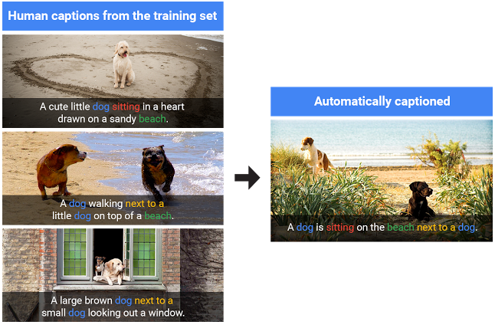
Image Caption Generator
Rukmini Annadata
222010326006

Slide 2
What is an Image Caption Generator?
1
Definition
2
Applications
3
Limitations
An image caption generator is a deep learning model that automatically generates descriptions of the content of an image.
Image caption generators have many useful applications, including for visually impaired individuals and as a tool for automatically captioning images in news articles and social media.
Current image caption generators perform well on simple objects, but have difficulty with complex scenes or abstract concepts.

Slide 3
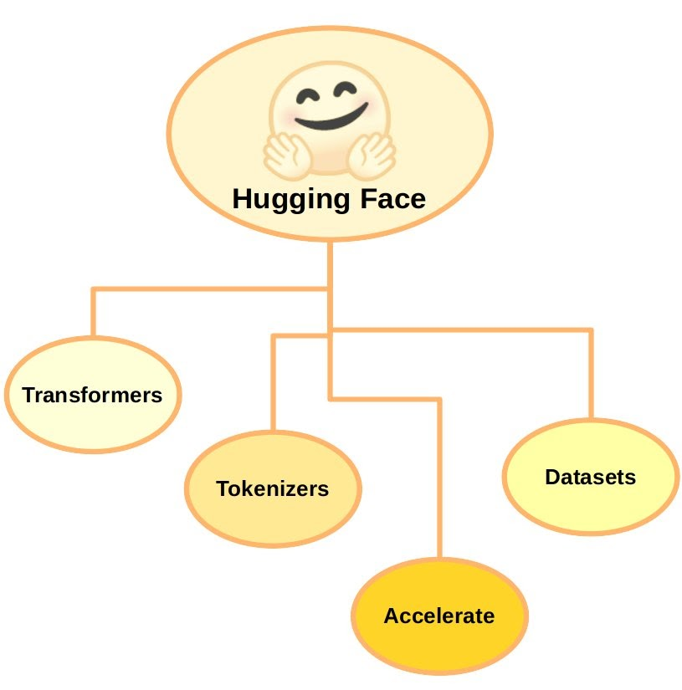

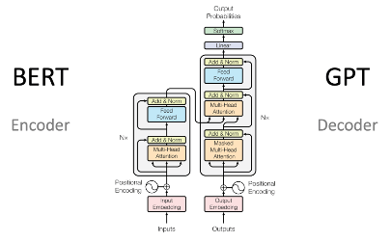
Overview of the Transformers Library
What are Transformers?
How Transformers Work
Transformer Architecture
Transformers are deep learning algorithms designed for natural language processing tasks such as text classification, language translation, and text generation.
Transformers use a multi-head attention mechanism to capture relationships between words in a sentence and generate a contextual representation of each word.
Transformers consist of an encoder and decoder, which use stacked layers of self-attention and feed-forward neural networks to generate sequences of text.

Slide 4
Steps to Build an Image Caption Generator Using Transformers
1
Data Collection
Collect a dataset of images and corresponding captions, such as the MSCOCO dataset.
Data Preprocessing
2
Preprocess the image and text data by transforming the images into a feature vector using a pre-trained convolutional neural network, and tokenizing the captions into a sequence of words.
3
Model Architecture
Create a transformer model that takes in the image feature vector and caption sequence and generates a probability distribution over the vocabulary for each word in the caption.
Training the Model
4
Train the model on the preprocessed data using a loss function such as categorical cross-entropy and backpropagation.

Slide 5
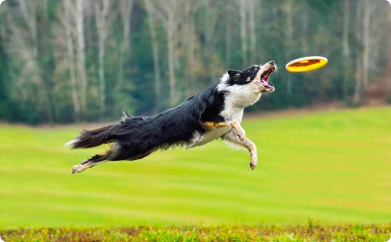
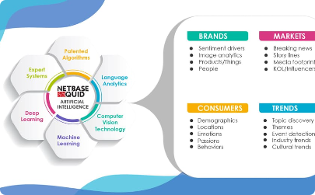
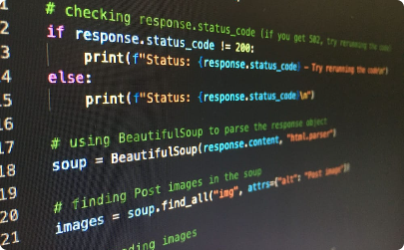
Data Preprocessing
Image Data
Text Data
Implementation Example
The image data must be normalized and transformed into a feature vector using pre-trained Vision Transformer (ViT) model for feature extraction.
The text data must be tokenized into a sequence of words and encoded into an input sequence for the model.
We can use popular machine learning libraries such as PyTorch or TensorFlow to preprocess the data.

Slide 6
Model Architecture
Encoder
Decoder
The encoder takes in the image feature vector and generates a hidden state for the transformer. In my code, this encoder is based on a Vision Transformer model.
The decoder is a transformer model that takes in the caption sequence and the hidden state from the encoder, and generates a probability distribution over the vocabulary for each word in the caption.
Vision Transformer (ViT) architecture
Generative Prerained Transformers-2

Slide 7
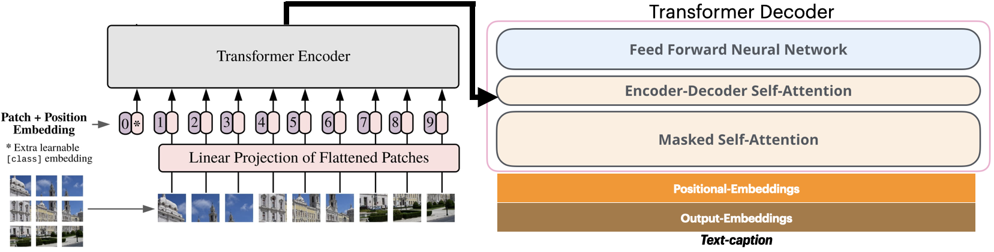
Model Architecture

Slide 8
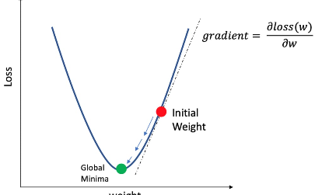
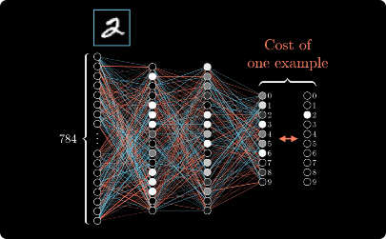
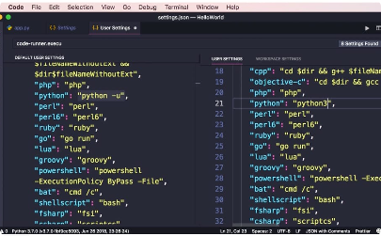
Training the Model
Loss Function
Backpropagation
Implementation Example
Categorical cross-entropy is a common loss function used for image caption generation.
Using “Seq2SeqLMHeadModel”
Backpropagation is used to update the weights of the model based on the error calculated by the loss function.
We can use popular machine learning libraries such as PyTorch or TensorFlow to train the model.
“Trainer” class used

Slide 9
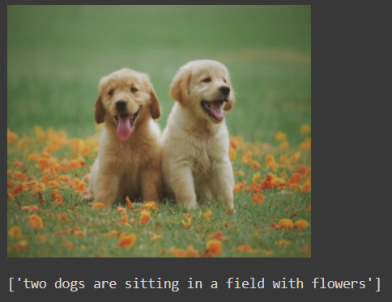
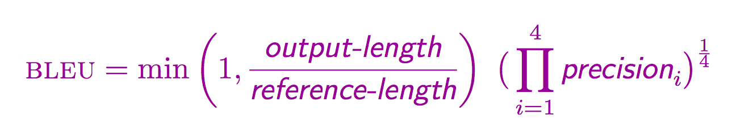
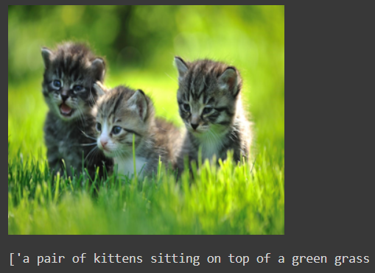
Evaluation metric and Output
BLEU Score (Range – 0 to 1)
Obtained – 0.83
The BLEU (Bilingual Evaluation Understudy) score is a metric used to evaluate the quality of machine-generated text, such as machine translation or text generation tasks like image captioning.

Slide 10
Conclusion
1
Summary
2
Future Directions
The transformers library provides a powerful framework for building image caption generators using deep learning.
Future work includes improving the performance of the model on complex scenes and exploring the use of unsupervised learning techniques.

